Slide 1
EE 210
LECTURE 5
THE OPERATIONAL AMPLIFIER
Cenk Efeler
Reference Book :Electric Cırcuits
James W.Nielson & Susan A.Riedel

Slide 2
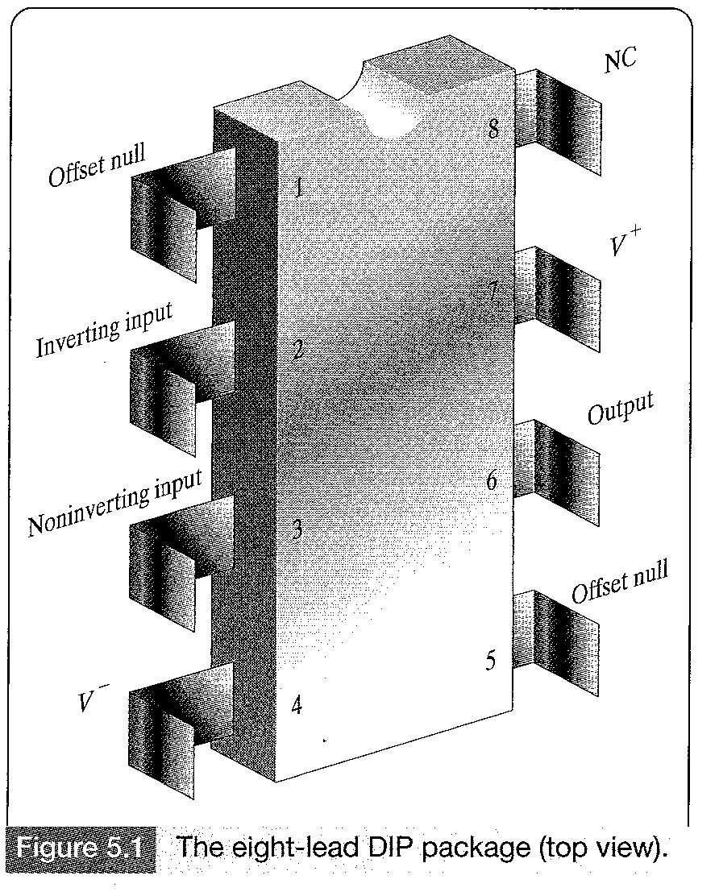
THE OPERATIONAL AMPLIFIER
The operational amplifier was initially used in analog circuits to implement mathematical operations like integration,differentiation,addition,sign changing and scaling.
Figure 5.1 displays an eight DIP (Dual in line package)
terminal operational amplifier.The terminals of primary
interest are:
- inverting input
- noninverting input
- output
- positive power supply (V+)
- negative power supply (V-)
The remaining three terminals are not of interest.

Slide 3
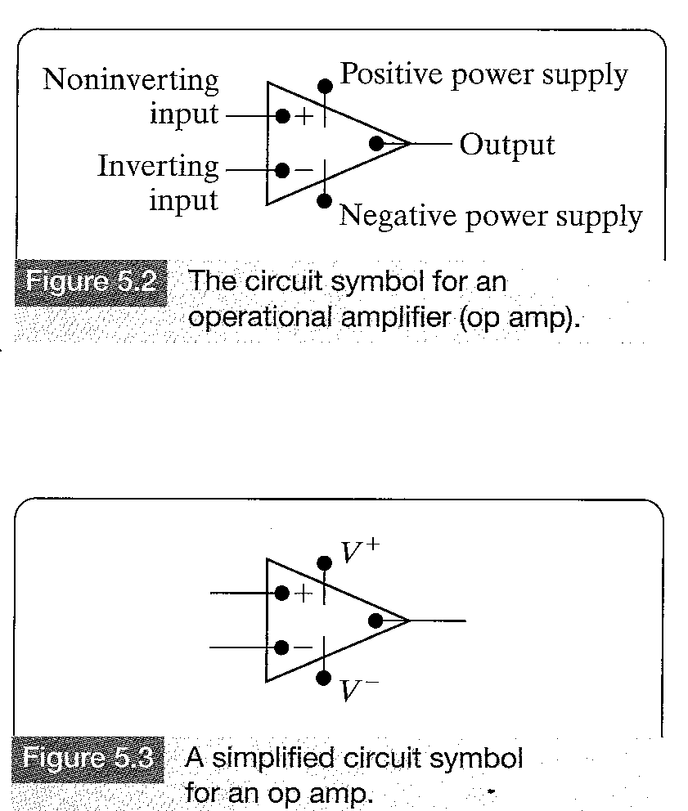
THE OPERATIONAL AMPLIFIER
The offset null terminals may be
used in an auxiliary circuit to
compensate for a degradation in
performance due to aging and
imperfections. However, as the
degradation in most cases is
negligible,the offset terminals in
most cases are not used.
Terminal 8 which is called
NC means no connection and it is
also not used.Thus the 8 terminal
circuit is simplified to the five
terminal circuit shown in Figure 5.2

Slide 4
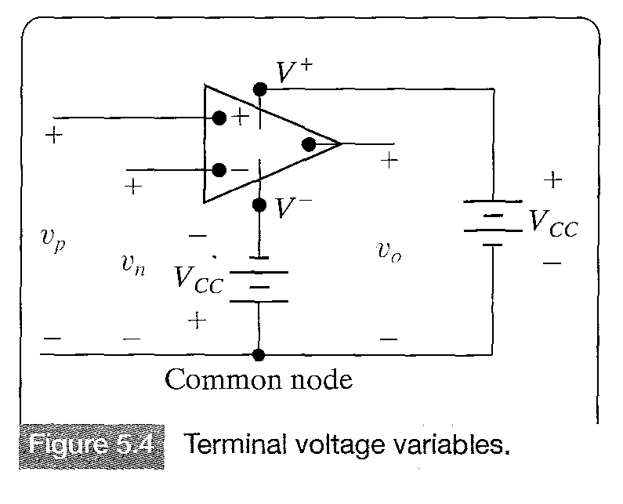
TERMINAL VOLTAGES AND CURRENTS

Slide 5
TERMINAL VOLTAGES AND CURRENTS
Like in the node-voltage analysis all voltages are considered as voltage rises from the common node.A positive supply voltage (Vcc) is connected between V+ and the common node.A negative supply voltage (-Vcc) is connected between V- and the common node.
The voltage between the inverting terminal and the common node is denoted vn.The voltage between the noninverting input terminal and the common mode is designated vp.
The voltage between the output terminal and the common node is denoted vo.

Slide 6
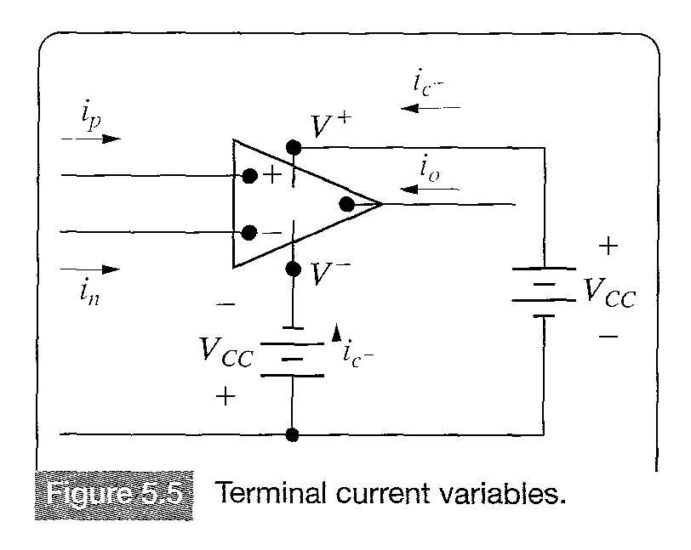
TERMINAL VOLTAGES AND CURRENTS
Figure 5.5 shows the current variables with their reference directions.Note that all current reference directions are into the terminals of the operational amplifier.
in : the current into inverting terminal
ip: the current into noninverting terminal
io: the current into the output terminal.
ic+: the current into positive power supply.
ic-: the current into negative power supply.
Common mode is external to the op
amp.It is the reference terminal of the
circuit in which the opamp is embedded.

Slide 7
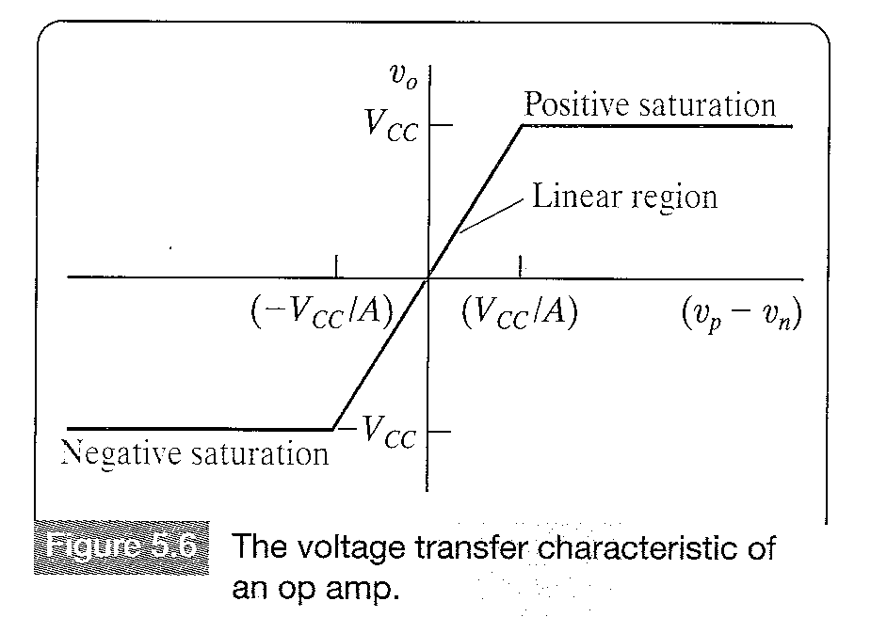
TERMINAL VOLTAGES AND CURRENTS
The voltage transfer function, that describes the variation of the output voltage in response to the input voltage is shown above. The output voltage is a function of the input voltage vp-vn.

Slide 8
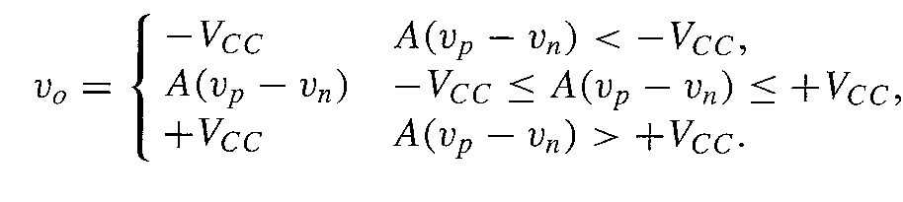
TERMINAL VOLTAGES AND CURRENTS
The equation for the voltage transfer characteristic is
The op amp has three distinct regions of operation.When the magnitude of the input voltage (|vp-vn|) is small,the op amp behaves as a linear device,since the output voltage is a linear function of the input voltages.
Outside this region the output of the op amp saturates and becomes a non linear function of the output voltage.
In the linear region of operation,the op amp’s output voltage is equal to the difference in its input voltages times the multiplying constant or gain A.

Slide 9
TERMINAL VOLTAGES AND CURRENTS
For most op amps the recommended dc power supply voltages seldom exceed 20V,and the gain is rarely less than 10,000, with these typical values looking at the above graph, we see that the magnitude of input voltage difference (|vp-vn|) must be less than 2 mV.
Typically,the node voltages of the circuits we study are larger than 2 mV,so a voltage difference of less than 2mV means that the two voltages are essentially equal.
Thus when an op amp is constrained to its linear operating region and the node voltages are much larger than 2mV,the constraint on the input voltages of the opamp is
vp = vn (5.2)

Slide 10
TERMINAL VOLTAGES AND CURRENTS
Equation 5.2 characterizes the relationship between the input voltages for an ideal op amp,that is an op amp whose value of A is infinite.
The input voltage constraint in Eq 5.2 is called the virtual short condition at the input of the op amp.
This is accomplished by feeding back the output signal to the input signal so that the output substracts from the input and the input voltage decreases.Because the output voltage is proportional to the input voltage difference,the output voltage is also decreased and the op amp operates in its linear region.
This configuration is known as negative feedback.

Slide 11
TERMINAL VOLTAGES AND CURRENTS
If a cırcuit containing an op amp does not provide a negative feedback path from the op amp output to inverting input,the op amp will normally saturate,unless the input signal is extremely small to prevent saturation with no negative feedback.
Even if the circuit provides a negative feedback path for the op amp,linear operation is not ensured.
Unless explicitly stated,we do not know whether the op amp is operating in the linear region or not,we simply assume that it is operating in the linear region,perform the circuit analysis and then check our results for contradictions.
If fo example,we compute the output voltage of the op amp to be 1V and the circuit analysis reveals that Vcc is 6V,there is a contradiction,beacuse the op amp’s output voltage cannot be larger than Vcc.
In this case our assumption of linear operation was not valid and the op amp output must be saturated at 6V.

Slide 12

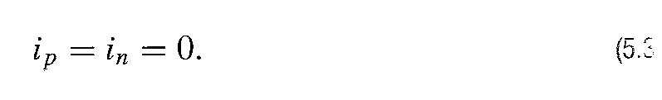
TERMINAL VOLTAGES AND CURRENTS
Equation 5.2 represents the voltage contraint for an ideal op amp,that is,with a gain value of A that is infinite based on the assumption that the op amp is operating in the linear region.
Analysis reveals that the equivalent input resistance seen by the input terminals of the op amp is very large,typically or more.
Ideally the input resistance is infinite,resulting in the current constraint.
Unlike the voltage constraint the current constraint is not based on the assumption that the op amp is confined to its linear operating region.Together Eqs 5.2 & 5.3 form the constraints or terminal behaviour that define our ideal op amp model.

Slide 13
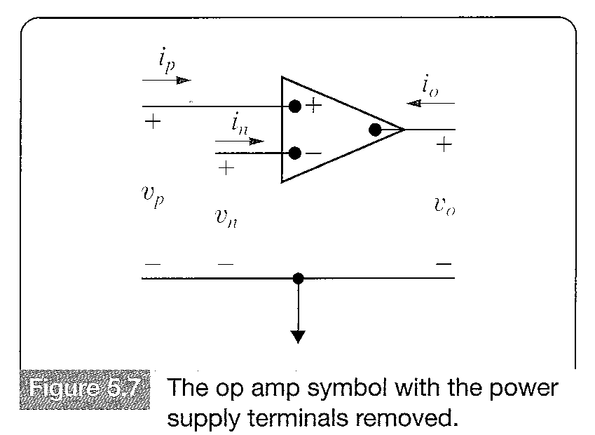
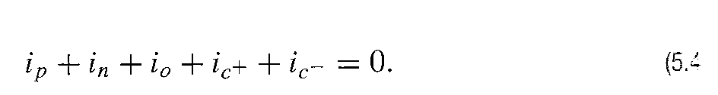
TERMINAL VOLTAGES AND CURRENTS
From Kirchoff’s Current Law,we know that the sum of currents entering the operational amplifier is zero,or

Slide 14
TERMINAL VOLTAGES AND CURRENTS
Substituting the constraint given by Eq (5.3) into Eq 5.4 gives
Equation 5.5 shows that eventhough there is negligible current at the input,there can be a significant amount of current at the output.
In Figure 5.7 the power supply terminals have been omitted, as we know that the op amp is operating in its linear region.This does not mean, however that ip+in+io=0.The ideal op amp constraint ip=in=0 does not imply io=0. The correct relationship between currents has been given by equation 5.4 and is equal to
The positive and negative power supply voltages do not have to be equal in magnitude.The value of A is not constant under all operating conditions.

Slide 15
TERMINAL VOLTAGES AND CURRENTS
Example 5.1
Homework – Assesing Objective 1- 5.1

Slide 16
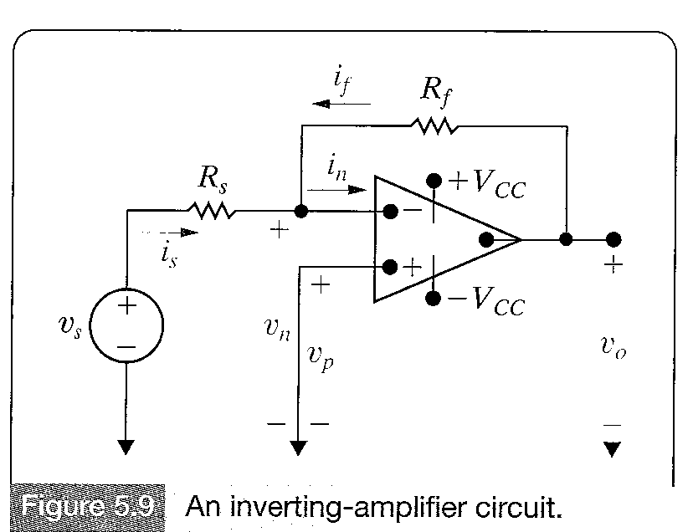

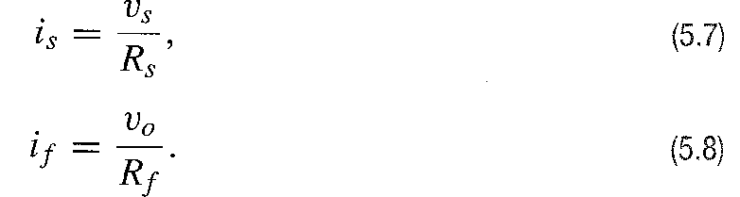
THE INVERTING AMPLIFIER CIRCUIT
Figure 5.9 shows an inverteramplifier
circuit.We assume that the op amp is
operating in its linear region and is
ideal.The goal is to express the output
voltage vo as a function of the source
voltage vs.
The voltage constraint of Eq 5.2 sets
the voltage at vn=0,because the
voltage at vp=0. Therefore,

Slide 17
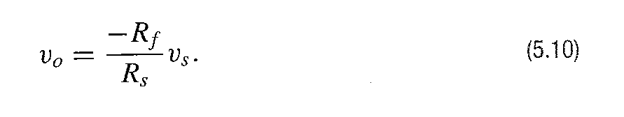
THE INVERTING AMPLIFIER CIRCUIT
From Eq 5.3 in=0,substituting Eqs 5.7-5.9 into Eqn 5.6,we get the desired relationship.
The output voltage is proportional to the negative of the input voltage,therefore the circuit is called inverting amplifier.The scaling factor or gain is the ratio Rf/Rs.
The above results is valid only if the op amp shown in Figure 5.9 is ideal,that is if A is infinite and the input resistance is infinite.

Slide 18
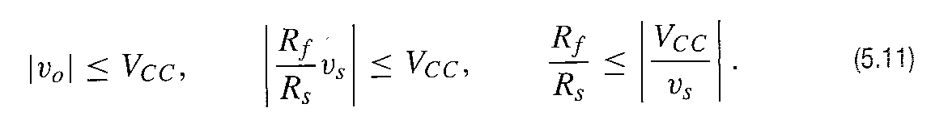
THE INVERTING AMPLIFIER CIRCUIT
For a practical (non-ideal) op amp equation (5.10) is only an approximation,usually a good one.
The upper limit on the gain of the inverting amplifier Rf/RS,is determined by the power supply voltages and the value of the input signal voltage vs.
Assuming equal power supply voltages V+=V-=Vcc,we get

Slide 19
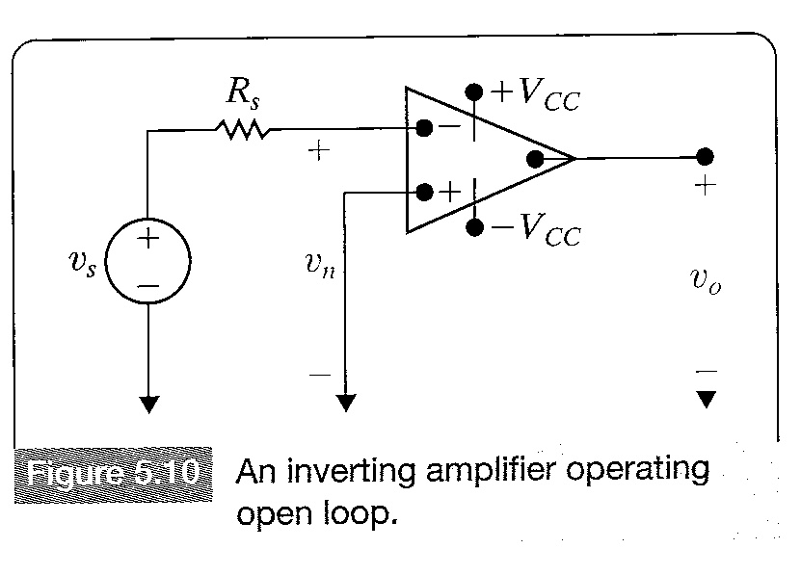
THE INVERTING AMPLIFIER CIRCUIT
If R1 is removed from the circuit,the feedback path is opened and the amplifier is said to be operating open loop.
Figure 5.10 shows the open-loop operation.

Slide 20
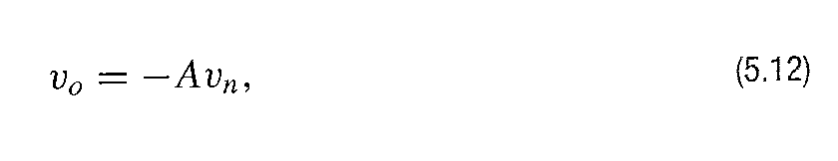
THE INVERTING AMPLIFIER CIRCUIT
Opening the feedback loop the output voltage becomes
Assuming as before V+=-V=Vcc then |Vn|<Vcc/A for linear operation. Because the inverting input current is almost zero,the voltage drop across Rs is almost zero,and the inverting input voltage almost equals the source voltage vs , vn vs.

Slide 21
THE INVERTING AMPLIFIER CIRCUIT
The op amp operates open loop in linear region only if |vs| < Vcc/A.If |Vs| >VCC/A,the op amp simply saturates.
If Vs < -Vcc/A,the op amp saturates at +Vcc and if Vs>VCC/A,the op amp saturates at –Vcc.
Because the relationship shown in Eq 5.12 occurs when there is no feedback path,the value of A is called open-loop gain of the op-amp.

Slide 22
THE INVERTING AMPLIFIER CIRCUIT
Homework Assessing Objective 2- 5.3

Slide 23
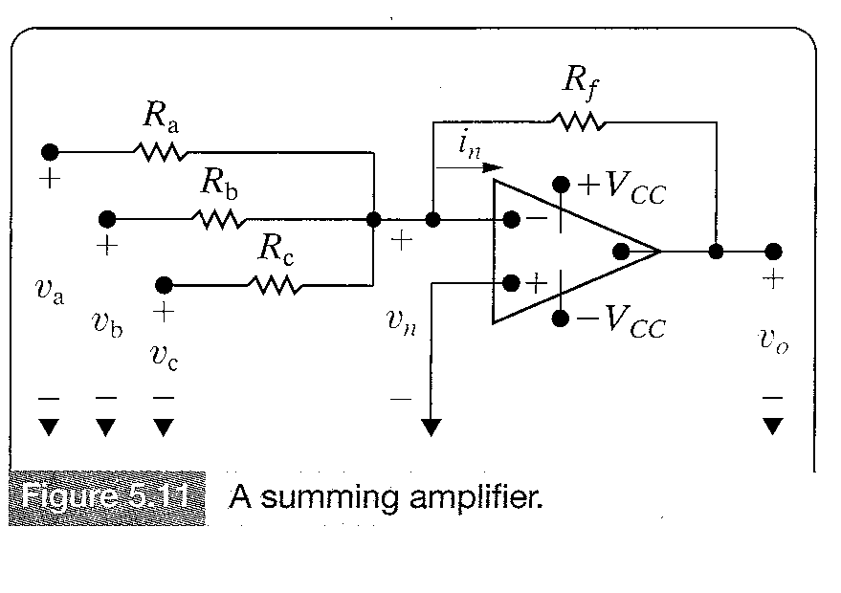
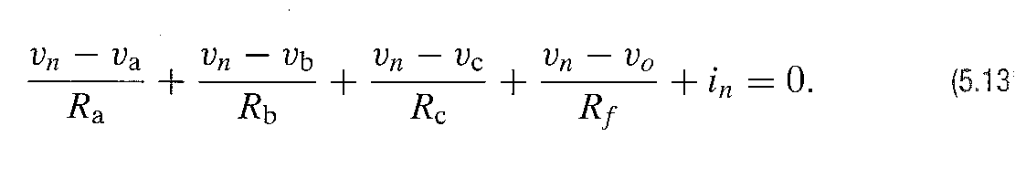
THE SUMMING AMPLIFIER CIRCUIT
By summing the currents away from the inverting input terminal:

Slide 24
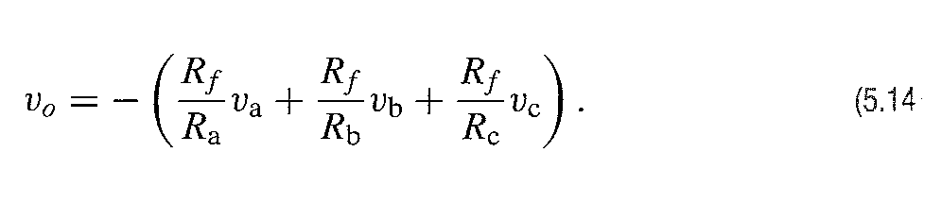
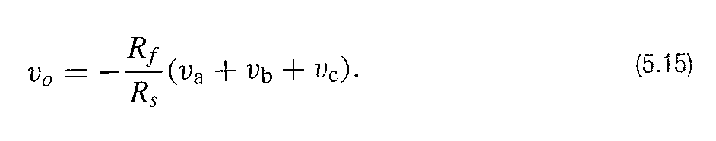
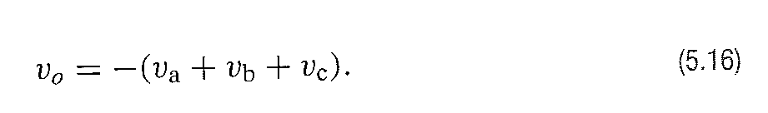
THE SUMMING AMPLIFIER CIRCUIT
Which reduces to
Equation 5.14 shows that the output voltage is an inverted,scaled sum of the three voltages.
If Ra=Rb=Rc,then Equation 5.14 reduces to
Finally,if we make Rf=Rs,the output voltage is inverted sum of the input voltages.That is

Slide 25
THE SUMMING AMPLIFIER CIRCUIT
Allthough the summing amplifier has been illustrated with just three input signals,the number of input voltages can be increased as needed.For example,16 individually recorded audio signals may be summed to form a single audio signal.
The summing amplifier configuration could include 16 different input resistor values so that each of the input audio tracks appear in the output signal with a different amplification factor.
The summing amplifier thus plays the role of an audio mixer.

Slide 26
THE SUMMING AMPLIFIER CIRCUIT
Homework Assessing Objective 2 - 5.3

Slide 27
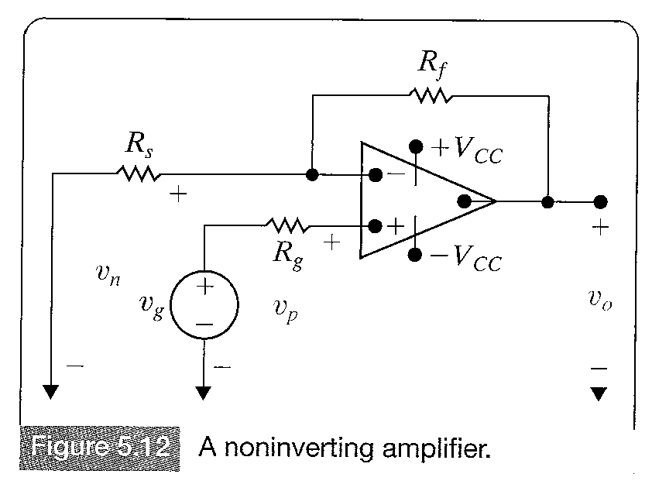
THE NONINVERTING AMPLIFIER CIRCUIT
We assume that the op amp is operating in its linear region and use Equations 5.2&5.3.
Because the op amp current is zero,we can write vp=vg and from Eq 5.2, vn=vg.

Slide 28
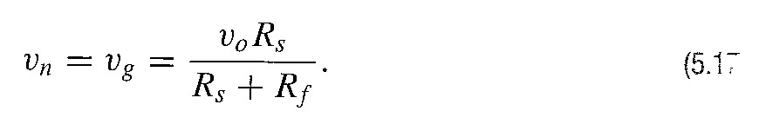
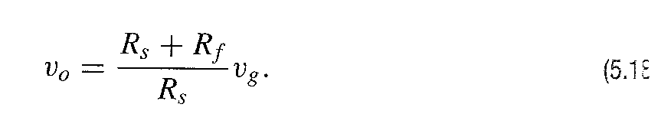
THE NONINVERTING AMPLIFIER CIRCUIT
Because the input current is zero (in=ip=0),the resistors Rf and Rs form an unloaded voltage divider across v0.Therefore,
Solving equation 5.17 for vo gives

Slide 29
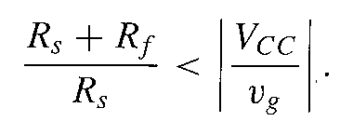
THE NONINVERTING AMPLIFIER CIRCUIT
Operation in the linear region requires that v0<|Vcc|,thus
Note again because of the ideal op amp assumption,we can express the output voltage as a function of the input voltage and the external resistors,in this case Rs and Rf.

Slide 30
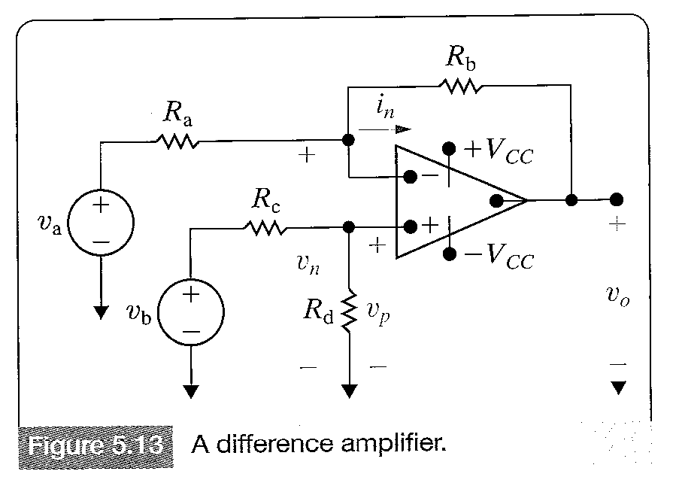
THE DIFFERENCE AMPLIFIER CIRCUIT
The output voltage of a difference amplifier is proportional to the difference between the two input voltages

Slide 31
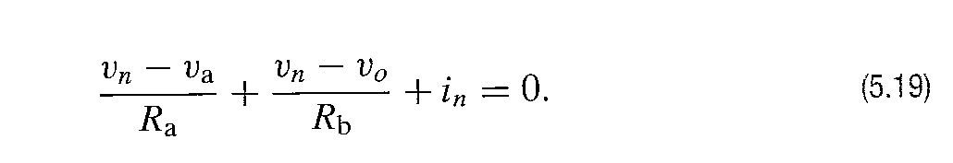
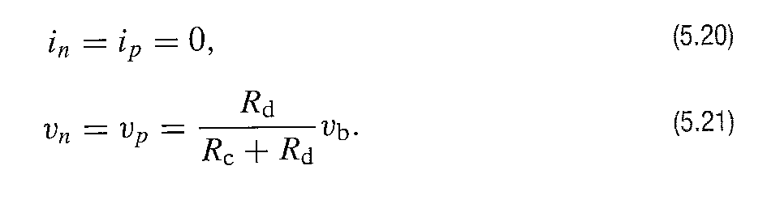
THE DIFFERENCE AMPLIFIER CIRCUIT
Assuming that the op amp is ideal and operating in its linear region of operation
Because the op amp is ideal,we use the voltage and current constraints to see that

Slide 32
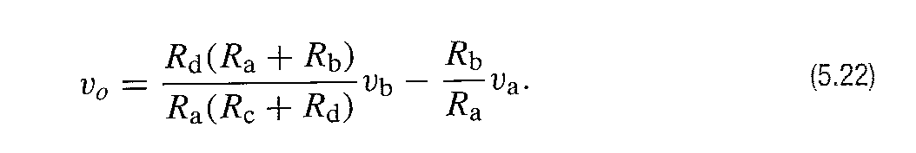
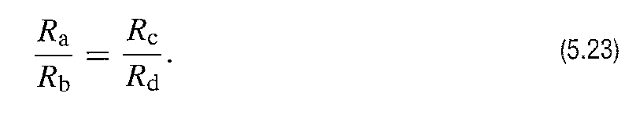
THE DIFFERENCE AMPLIFIER CIRCUIT
Combining Eqs 5-19,5-20 and 5-21 gives the desired relationship between the output voltage and the input voltages va and vb.
The ouput voltage is proportional to the difference between a scaled replica of vb and a scaled replica of va.In general the scaling factor applied to vb is not the same as the scaling factor applied to va.However,the scaling factor applied to each input voltage can be made equal by setting

Slide 33
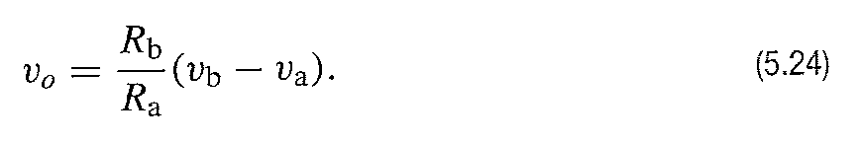
THE DIFFERENCE AMPLIFIER CIRCUIT
When equation 5.23 is satisfied,
Eqn 5.24 indicates that the output voltage can be made a scaled replica of the difference between the input voltages vb and va.
The output voltage only depends on the resistors Rb and Ra and is not effected by a load resistor connected across the output of the amplifier.

Slide 34
THE DIFFERENCE AMPLIFIER CIRCUIT
Homework Assessing Objective 2 – 5.5

